Slide 1

PROJECT PRESENTATION ON-
UBER RELATED DATA ANALYSIS USING MACHINE LEARNING
h
Project Guide:
Mrs. M. Bharathi
Project by:
19361A0537
19361A0556
19361A0521
19361A0553

Slide 2

ABSTRACT
The Uber platform links you to drivers who can take you to your destination.
Our analysis will focus on answering several key questions, such as:
What are the peak hours and days of the week for Uber trips?
What are the most popular pickup and drop off locations for Uber trips?
The model is employed using clustering algorithms to predict the demand on points of the city.

Slide 3
INTRODUCTION
In this data analysis project, we aim to explore various aspects of Uber's operations using a dataset of Uber trips in a major metropolitan city.
We will use a combination of descriptive statistics, data visualization, and machine learning techniques to gain insights into Uber's operations.
The dataset contains information of Uber trips, including pickup and drop off locations, dates and times.

Slide 4
PROPOSED SYSTEM
Clustering algorithms are used to estimate the most likely collection points at a given time and to predict the best hotspots of nightlife learning trends from previous Uber pickups.
To conduct this data analysis project on Uber, we will use the Python programming language and various data analysis and visualization libraries, such as Pandas, NumPy, Matplotlib, and Seaborn.

Slide 5
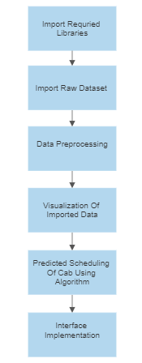
METHODOLOGY

Slide 6
LIBRARIES
Pandas
Numpy
Seaborn
Matplotlib
Flask
Folium
Scikit-Sklearn
Kneed

Slide 7
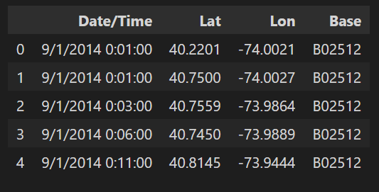
DATA SET

Slide 8
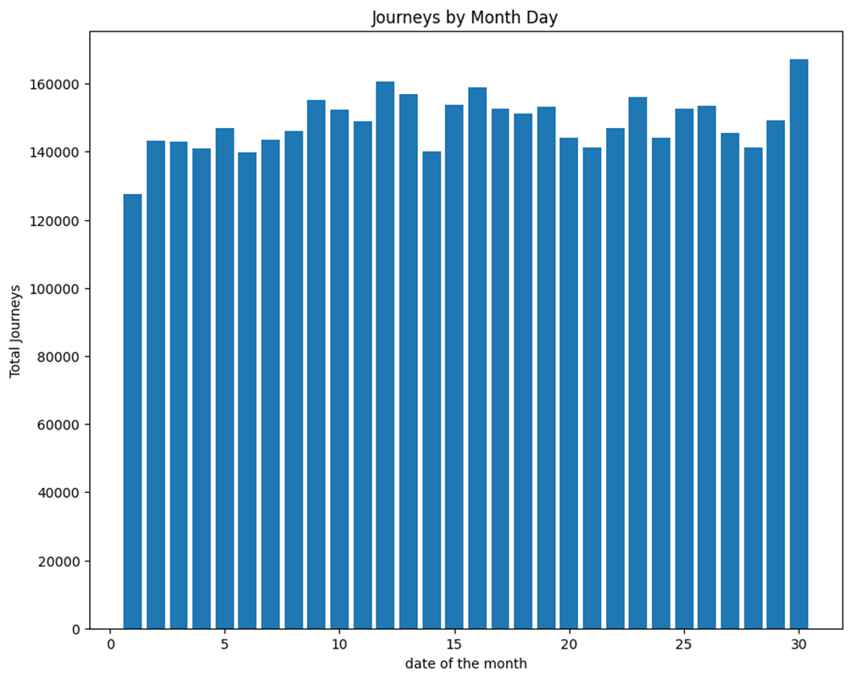
VISUALIZATION

Slide 9
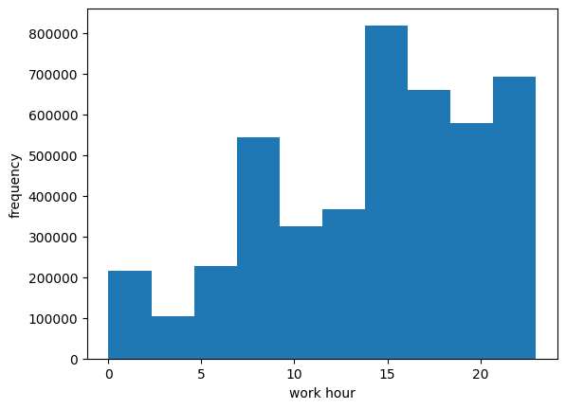

Slide 10
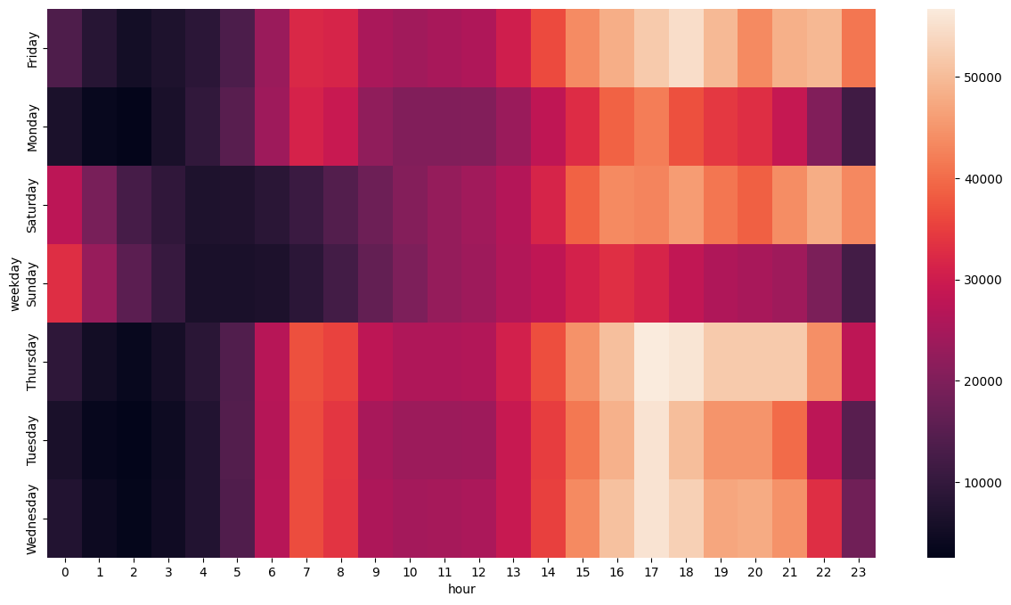

Slide 11
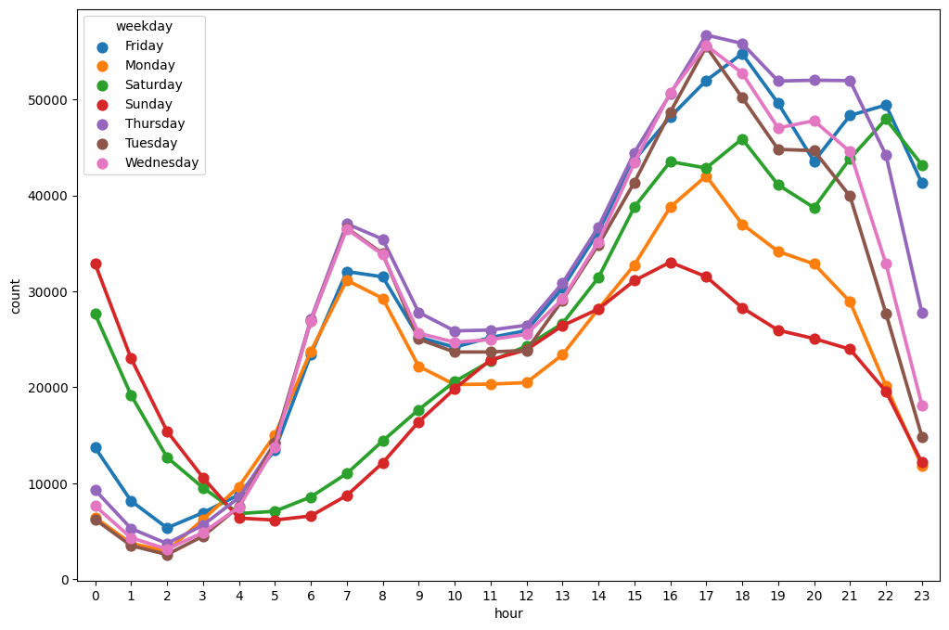

Slide 12
ALGORITHMS
KMeans algorithm
The algorithm used is involved on the concept of k-means clustering algorithm. which belongs to unsupervised learning. There is no labeled data for this clustering, unlike in supervised learning. K-Means performs division of objects into clusters that share similarities and are dissimilar to the objects belonging to another cluster

Slide 13
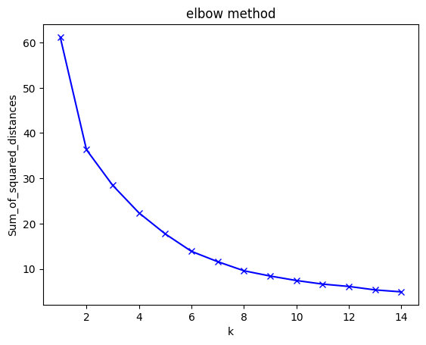
Kneed

Slide 14
2. DBSCAN
DBSCAN - Density-Based Spatial Clustering of Applications with Noise. Finds core samples of high density and expands clusters from them. Good for data which contains clusters of similar density.

Slide 15
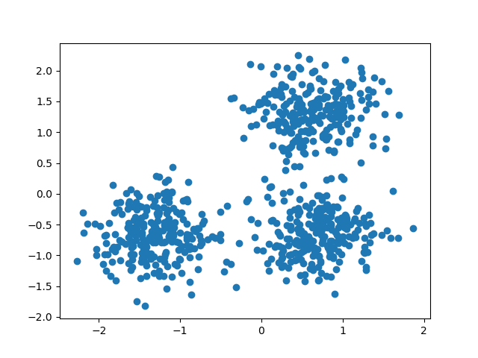

Slide 16
3. Agglomerative Clustering
The agglomerative clustering is the most common type of hierarchical clustering used to group objects in clusters based on their similarity. It’s also known as AGNES (Agglomerative Nesting). The algorithm starts by treating each object as a singleton cluster. Next, pairs of clusters are successively merged until all clusters have been merged into one big cluster containing all objects. The result is a tree-based representation of the objects, named dendrogram.

Slide 17
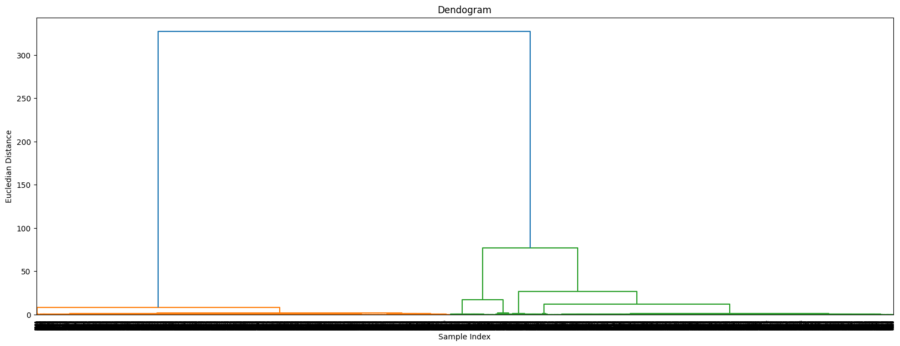
Dendogram

Slide 18
4. Kmedoid algorithm
The k-medoids problem is a clustering problem similar to k-means. Both the k-means and k-medoids algorithms are partitional (breaking the dataset up into groups) and attempt to minimize the distance between points labeled to be in a cluster and a point designated as the center of that cluster.

Slide 19
RESULTS AND DISCUSSION
The program predicts the pickup location of the cab based on the clusters plotted using applied by KMeans, KMediod, Agglomerative clustering and Gaussian Mixture Models for appropriate cab scheduled for pickup.

Slide 20
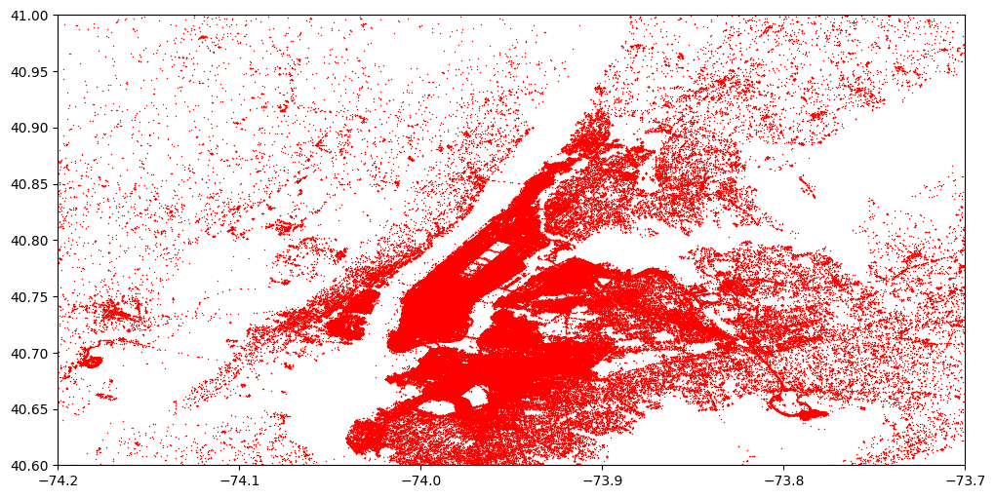
The results discussed are based on the following figures below

Slide 21
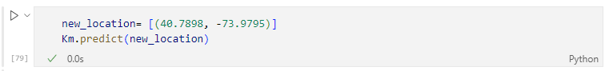
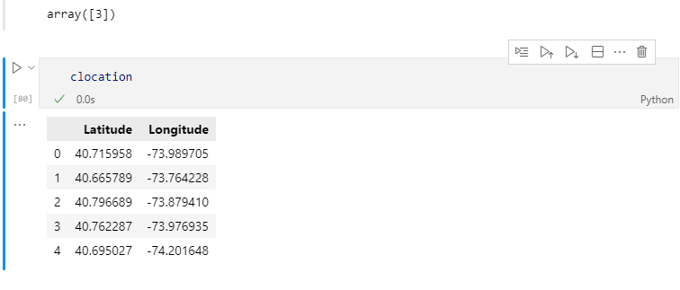

Slide 22
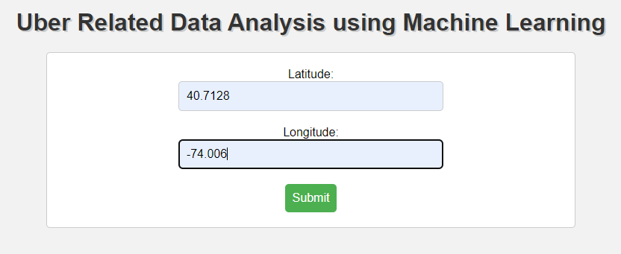
User Interface
We have built the UI from where user can easily use the model. User can insert the latitude and longitude which can get the predicts the pickup location of the cab.

Slide 23
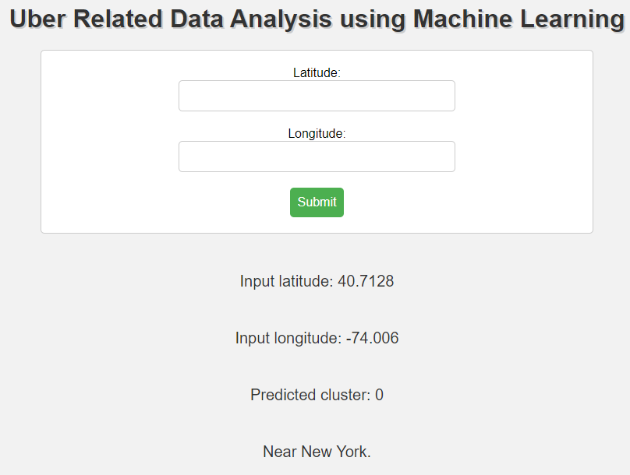

Slide 24
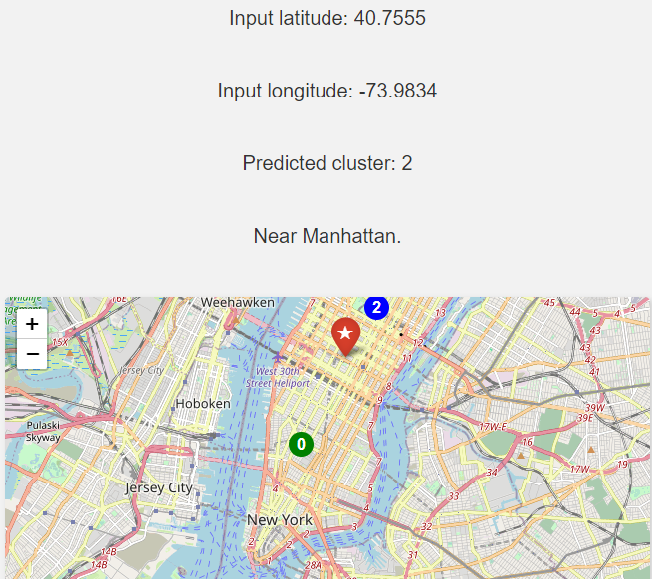

Slide 25
ADVANTAGES
Improves customer satisfaction and retention.
Identifies inefficiencies and areas for improvement.
Improves efficiency.
Increases profitability for Uber.

Slide 26
FUTURE SCOPE
The future work suggests that the system will provide the location to the user. The algorithm then records the time, latitude, longitude of the trip and assigns it to a cluster nearest to the passenger location where a cab is scheduled for pickup. We can also predict the passenger count on each district to deploy more cabs to the clustered coordinates using convolutional neural networks (CNN)

Slide 27
CONCLUSION
The conclusion of the project is to project a basic outline of trips travelled with respect to latitude and longitude of locations.
The merit of the project is that it explains the functioning of how cabs are assigned to passengers.
The ultimate aim of the project is to predict the pickup of the cab on the basis of clusters defined by the clustering algorithms.

Slide 28
T
H
A
N
K
Y
O
U

